Slide 1
Central Processing Unit Organization
Register Organization and Stack Organization

Slide 2
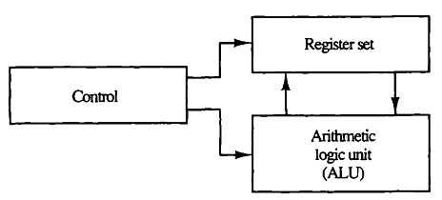
Central Processing Unit
The CPU is made up of three major parts
1) Register Set
2) ALU
3) Control Unit
Fig: Major components of CPU.

Slide 3
Central Processing Unit
The register set stores intermediate data used during the execution of the instructions.
The arithmetic logic unit (ALU) performs the required microoperations for executing the instructions.
The control unit supervises the transfer of information among the registers and instructs the ALU as to which operation to perform.
Fig: Major components of CPU.

Slide 4
General Register Organization
Earlier, we used memory locations to store pointers, counters, return address, temporary results, and partial products during multiplication, etc.
Memory access is the most time-consuming operation in a computer
More convenient and efficient way is to store intermediate values in processor registers
When a large number of registers are included in the CPU, it is most efficient to connect them through a common bus system

Slide 5
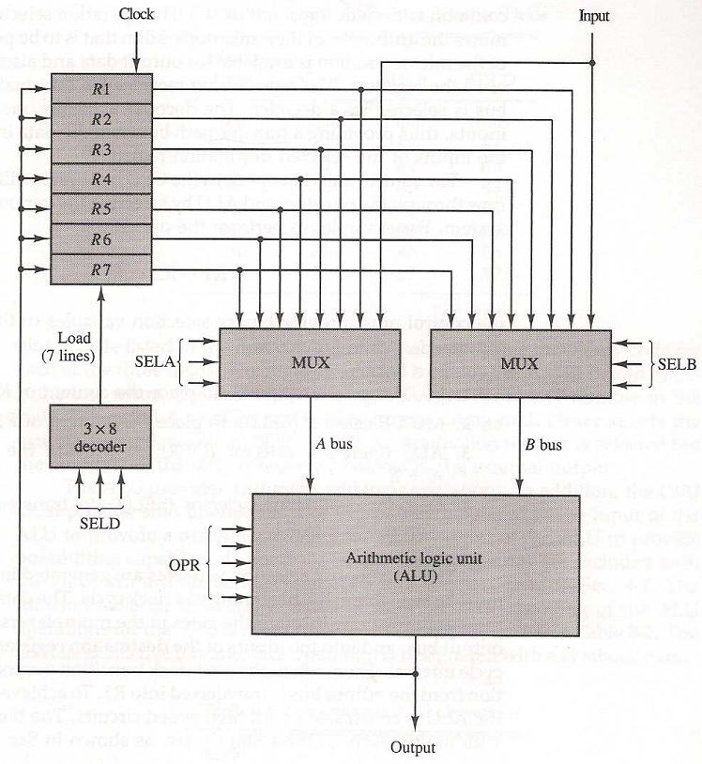
General Register Organization
Fig: Register set with common ALU

Slide 6
General Register Organization
Fig shows Bus organization for 7 CPU registers
2 MUX : select one of 7 register or external data input by SELA and SELB
BUS A and BUS B : form the inputs to a common ALU
ALU : OPR determine the arithmetic or logic microoperation
3 X 8 Decoder : select the register (by SELD) that receives the information from ALU
The result of the microoperation is available for external data output and also goes into the inputs of all the registers

Slide 7
General Register Organization
For example, to perform the operation
Binary selector inputs:
MUX A selector (SELA) : to place the content of R2 into BUS A
MUX B selector (SELB) : to place the content of R3 into BUS B
ALU operation selector (OPR) : to provide the arithmetic addition R2 + R3
Decoder selector (SELD) : to transfer the content of the output bus into R1

Slide 8
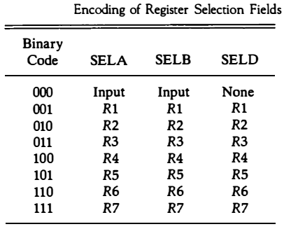
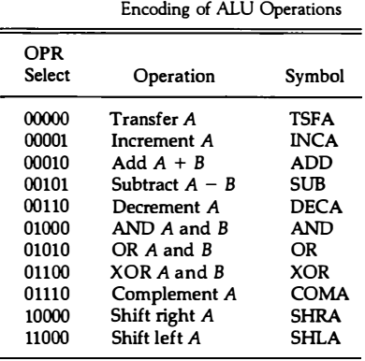
General Register Organization
For example, to perform the operation

Slide 9
General Register Organization
Control word is a combination of 4 fields and consists 14 bit
SELA (3 bits) : select a source register for the A input of the ALU
SELB (3 bits) : select a source register for the B input of the ALU
SELD (3 bits) : select a destination register using the 3 X 8 decoder
OPR (5 bits) : select one of the operations in the ALU

Slide 10

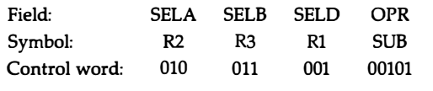
General Register Organization
For example, to perform the operation

Slide 11
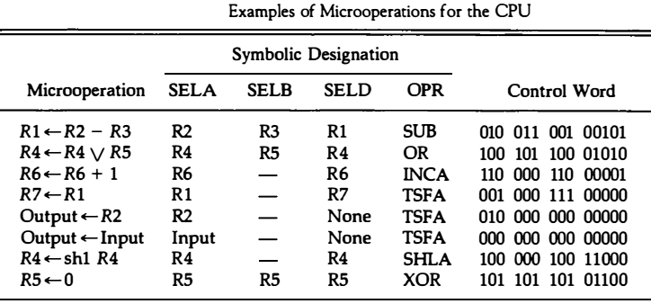

Slide 12
General Register Organization
The increment and transfer microoperations do not use the B input of the ALU. For these cases, the B field is marked with a dash.
We assign 000 to any unused field when formulating the binary control word
The direct transfer from input to output is accomplished with a control word of all 0's.

Slide 13
Stack Organization
A stack is a storage device that stores information in such a manner that the item stored last is the first item retrieved.
Stack or LIFO(Last-In, First-Out)
Stack Pointer (SP)
The register that holds the address for the stack
SP always points at the top item in the stack
Two Operations of a stack : Insertion and Deletion of Items
PUSH : Push-Down = Insertion
POP : Pop-Up = Deletion

Slide 14
Stack Organization
Stack can be implemented by using two ways:
Register Stack
A finite number of memory words or register.
Memory Stack
A portion of a large memory

Slide 15
Register Stack
A stack can be placed in a portion of a large memory or it can be organized as a collection of a finite number of memory words or registers.
The stack pointer register SP contains a binary number whose value is equal to the address of the word

Slide 16
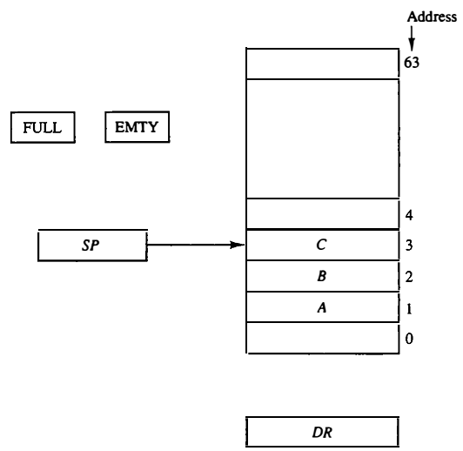
Register Stack
Initially, SP is cleared to 0, EMTY is set to 1, and FULL is cleared to 0, so that SP points to the word at address 0 and the stack is marked empty and not full.
In this diagram, three items are placed in the stack: A, B, and C, in that order. Item C is on top of the stack so that the content of SP is now 3.

Slide 17


Register Stack- Push
To insert a new item, the stack is pushed by incrementing SP and writing a word in the next-higher location in the stack.

Slide 18
Register Stack- Push
When 63 is incremented by 1, the result is 0 since 111111 + 1 = 1000000 in binary, but SP can accommodate only the six least significant bits.

Slide 19
Register Stack- Pop
To remove the top item, the stack is popped by reading the memory word at address 3 and decrementing the content of SP
A new item is deleted from the stack if the stack is not empty (if
EMTY = 0).

Slide 20
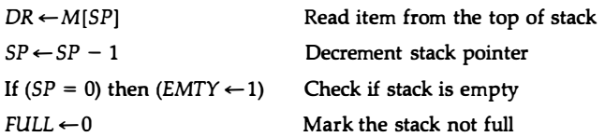
Register Stack- Pop
To remove the top item, the stack is popped by reading the memory word at address 3 and decrementing the content of SP

Slide 21
Memory Stack
Stack
Register Stack
Memory Stack

Slide 22
Memory Stack
A Stack can be implemented in a random-access memory.
The implementation of a stack in the CPU is done by assigning a portion of memory to a stack operation and using a processor register as a stack pointer.
The stack pointer SP points at the top of the stack.
SP is used to push or pop or pop items into or from the stack.

Slide 23
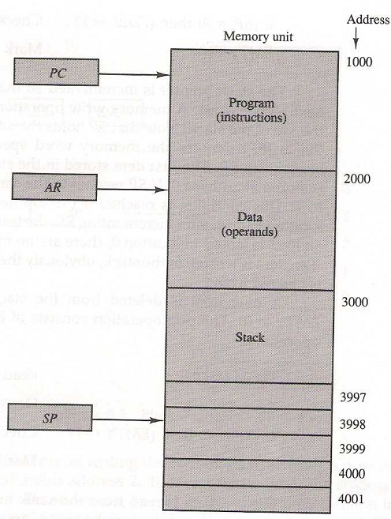
Memory Stack
The initial value of SP is 4001 and the stack grows with decreasing addresses.
Thus the first item stored in the stack is at address 4000, the second item is stored at address3999, and the last address that can be used for the stack is 3000.

Slide 24


Memory Stack
A new item is inserted with the push operation as follows:
A new item is deleted with a pop operation as follows:

Slide 25
Memory Stack
Most computers do not provide hardware to check for stack overflow (full stack) or underflow (empty stack).
The stack limits can be checked by using two processor registers:
One to hold the upper limit (3000 in this case), and
The other to hold the lower limit (4001 in this case).

Slide 26
Memory Stack
The stack may be constructed to grow by increasing the memory address.
In such a case, SP is incremented for the push operation and decremented for the pop operation.
A stack may be constructed so that SP points at the next empty location above the top of the stack.
In this case the sequence of microoperations must be interchanged

